Slide 1

Generative AI: AI Webdesigner
A tool that creates and illustrates a webpage based on Amazon product page
Heansuh Lee

Slide 2
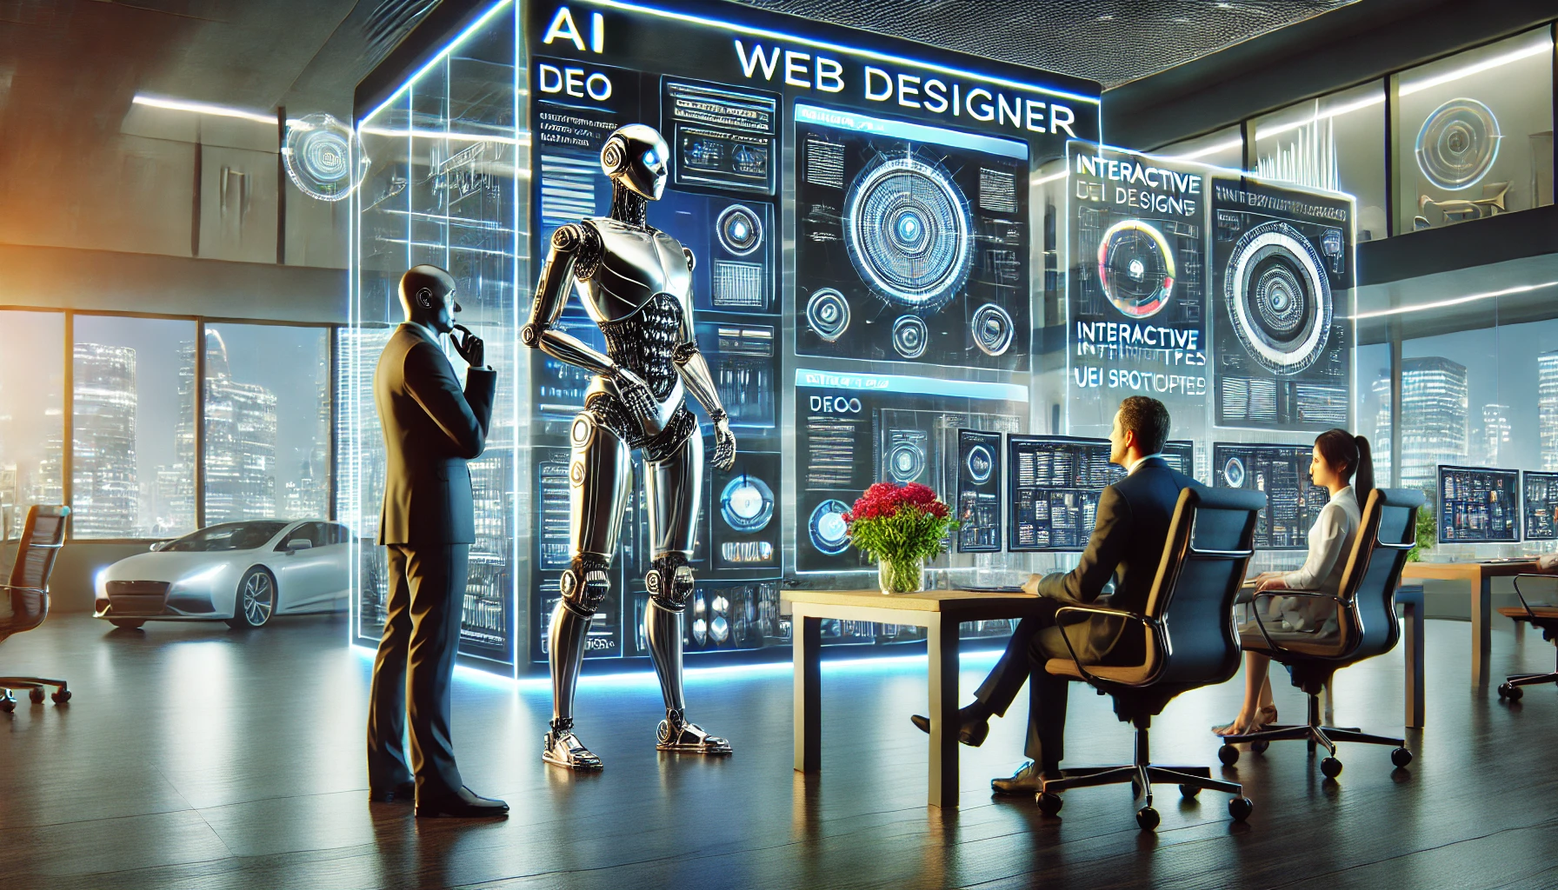
Motivation
Worked on Amazon web scraper before on products overview page
Good idea to work on Amazon product metadata to fulfill the project, scraped from product page
About me
Working for Philips as Working Student for Consumer Insights & Commercial Analytics
Past: Rental company in Seoul for rental products, then flooring products in Germany for logistics + product development
Strong interest in consumer products / CPG

Slide 3
Approach
Aim: Making a HTML page of a company website with a company logo and product images
To guide people in making websites with HTML structure
Data Preparation
For this, you can use any electronics product page link from Amazon as an input – only a single link can be used Electronics only because the dataset was too big (…), so it was reduced to randomised sample of 10000 products in sampled data
Web scraper will run and produce a dictionary data
This will be used for RAG pipeline

Slide 4
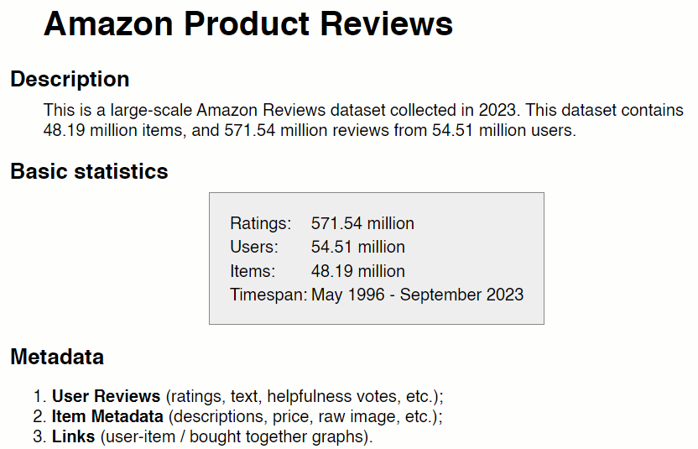
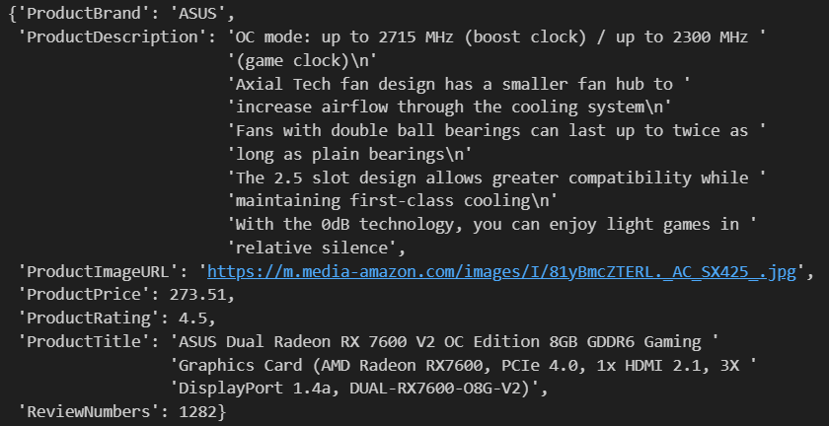
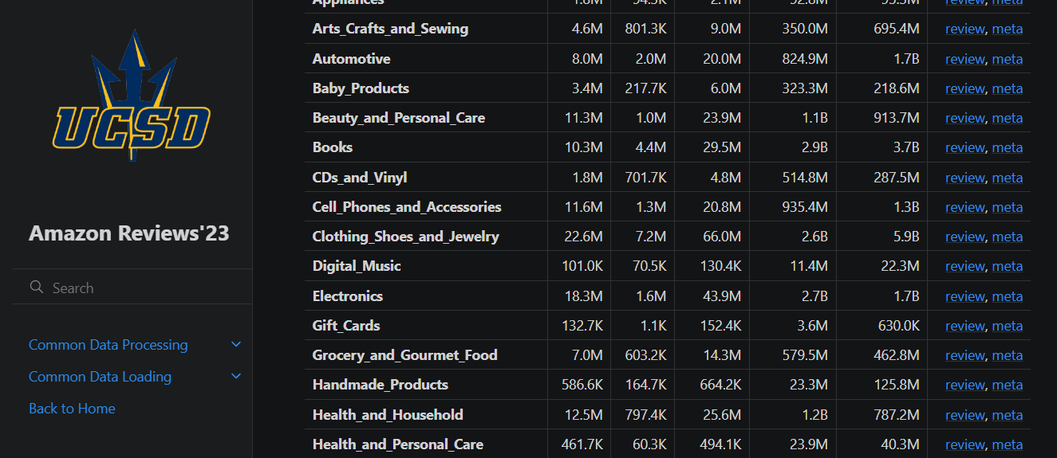
Approach

Slide 5
RAG
RAG pipeline
The electronics Amazon product metadata dataset is taken from Recommender Systems and Personalization Datasets [1]
Rich, structured data in .jsonl format
SentenceTransformer all-MiniLM-L6-v2 s used
This is where the input will retrieve products
Top 3 most similar products (using cosine similarity) will be returned from the vector database Qdrant
Query using only ‘ProductTitle’ and ‘ProductDescription’
Only relevant metadata is extracted from Amazon
At the end, only 1st product will be used for LLM

Slide 6
RAG
vectorised
Scraped data
extracted
concatenated
‘ProductTitle’
‘ProductDescription’
queried
meta_Electronics_sampled.jsonl
vectorised
Output
Qdrant vector database
Top 3 documents
Amazon metadata
stored
extracted randomly + undersampled
LLM

Slide 7
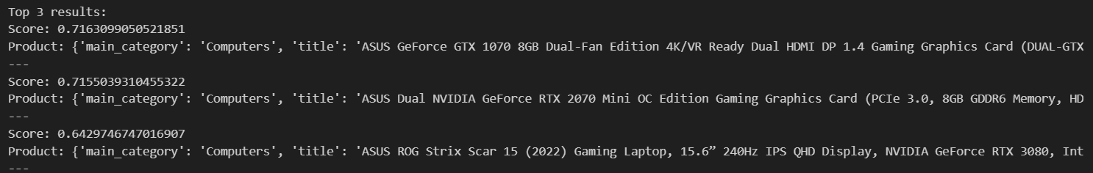
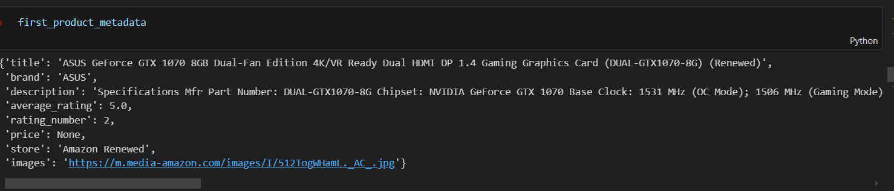
RAG

Slide 8
Agents
Multiple Agents
Attempted to make CoT using langchain, but not successful
Nevertheless, multiple agents are established:
“Enhanced” Metadata Generator: Based on the ‘specifications’, it returns the enhanced_metadata in .json format → Finetuned with higher temperature and also higher max_new_tokens
HTML Generator: Given the input from “enhanced” metadata, it is able to generate HTML structure from enhanced_metadata → Finetuning was at a moderate level so that the HTML structure will be kept, temperature is moderate with lower max_new_tokens
Both agents used same LLM: Qwen/Qwen2.5-Coder-7B-Instruct

Slide 9
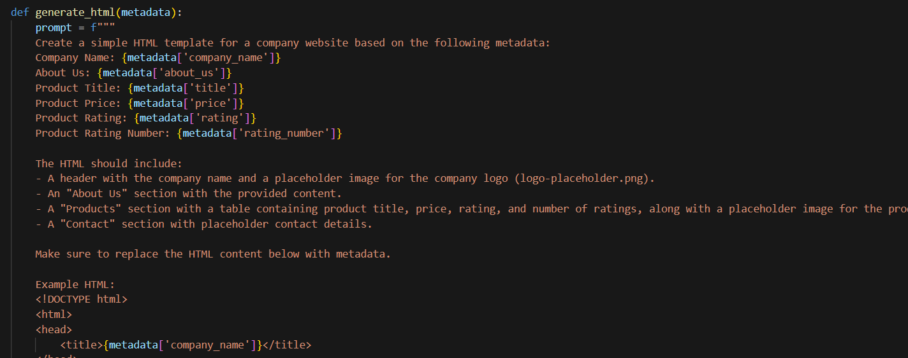
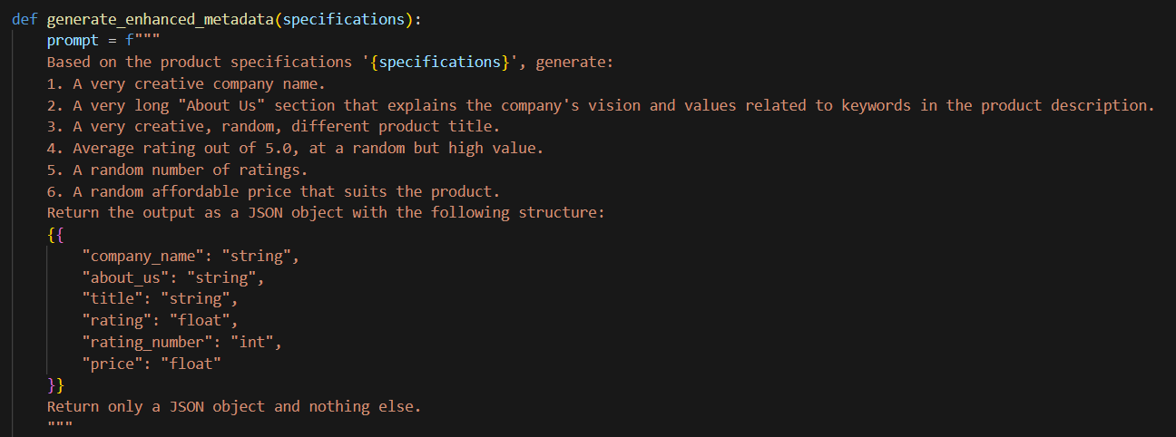
Approach

Slide 10
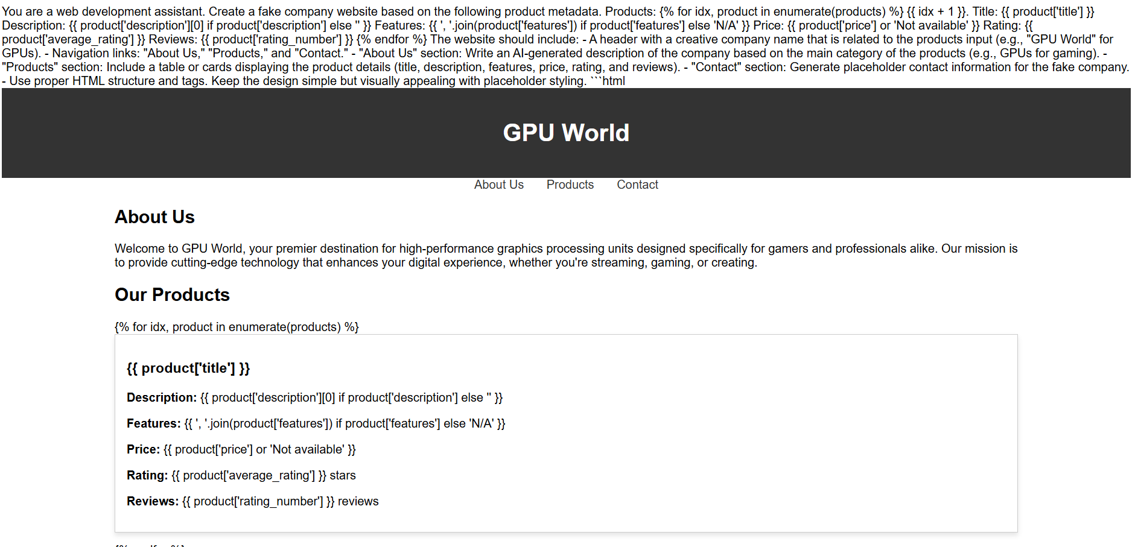
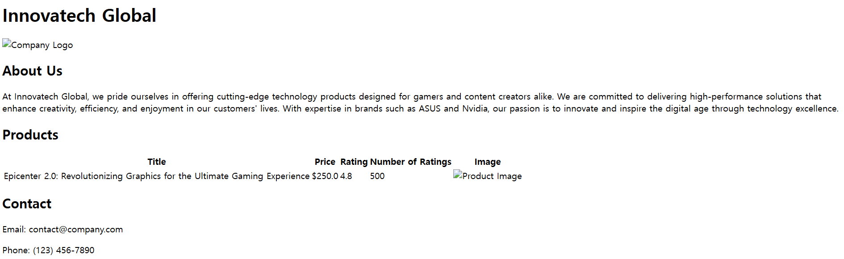
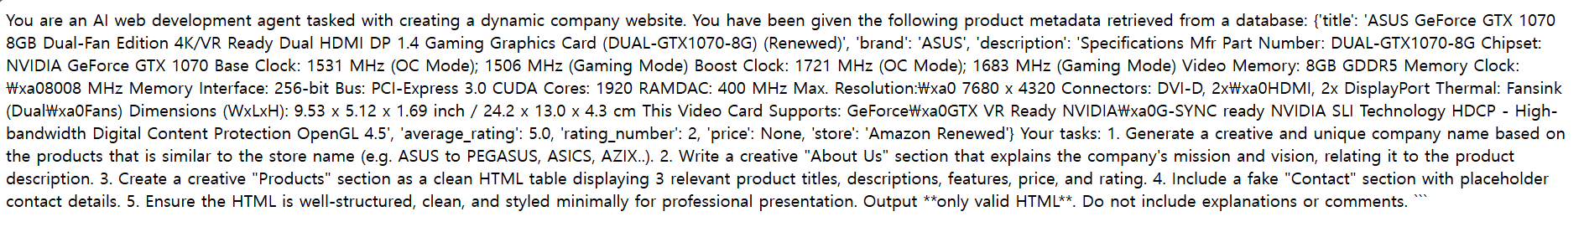
HTML pages

Slide 11

Image Generation
HTML page is made successfully!
Now, image generation on company logo + product image
Product Image
Model: thu-ml/unidiffuser-v1
Image-to-text-to-image approach, as image is provided from the Amazon metadata
Able to retrieve the text in a similar way → Finetuned with guidance_scale = 8 to make it strict, temperature at default

Slide 12


Image Generation
Company Logo
Model used: ntc-ai/SDXL-LoRA-slider.futuristic-logo-design [2]
Searched ‘logo’ on HuggingFace, but somehow Flux was not usable on Jupyter Server
This model uses LoRA in stable diffusion and makes “futuristic logo design”
Other logo model (artificialguybr/LogoRedmond-LogoLoraForSDXL-V2) was also available, but documentation was completely(!) missing:
→ Finetuned with the parameters in the next slide

Slide 13



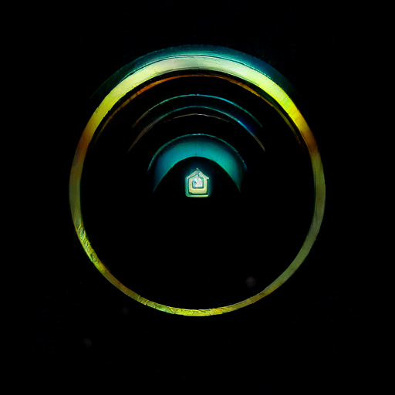
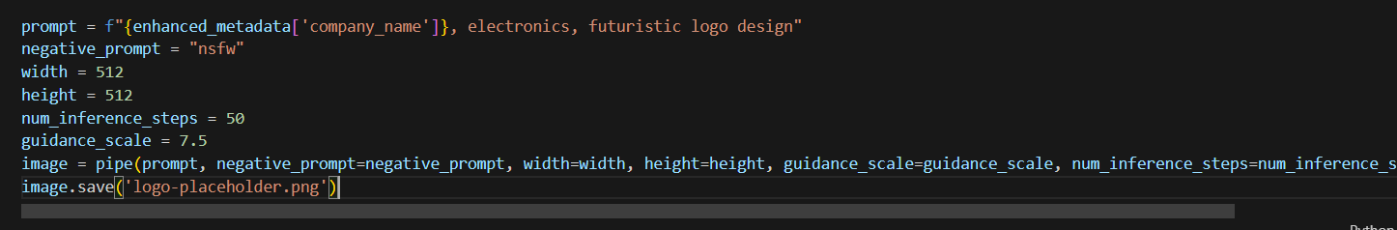
Image Generation
Innovapic: guidance_scale = 2
Pretty good! But num_inference_steps was lower
Some wing logo..? guidance_scale = 6
Is this a logo? guidance_scale = 9

Slide 14
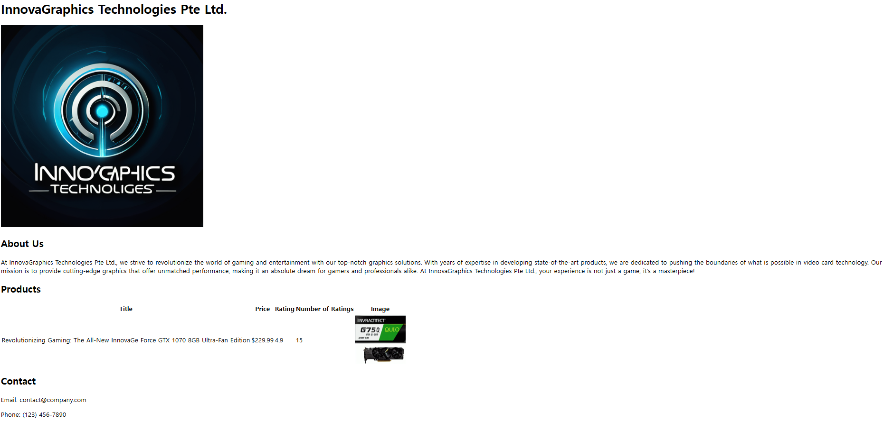

Final Version

Slide 15
Future Works
Overall success! However, there needed to be some tweaks done in the functions, to make the codes work smoothly (i.e. agents with .json / .html format, the response itself had to be extracted)
Simple HTML is not good enough: what about interactive websites (i.e. CSS, JavaScript)? How about mobile?
More prone to errors, the structures must be engineered for prompts
More lengthy description?
About ethics: would it be okay to use Amazon product pages as input and get inspirations from there? No copyright issues?
Some things can just get better as time goes, with better LLMs suited for text/image generation, and for website builders

Slide 16
References
Background image generated by DALL-E.
[1] Recommender Systems and Personalization Datasets. https://cseweb.ucsd.edu/~jmcauley/datasets.html#amazon_reviews, https://amazon-reviews-2023.github.io
[2] SDXL LoRA. https://huggingface.co/ntc-ai/SDXL-LoRA-slider.futuristic-logo-design

